Slide 1

Chapter 7
Rotational Motion

Slide 2
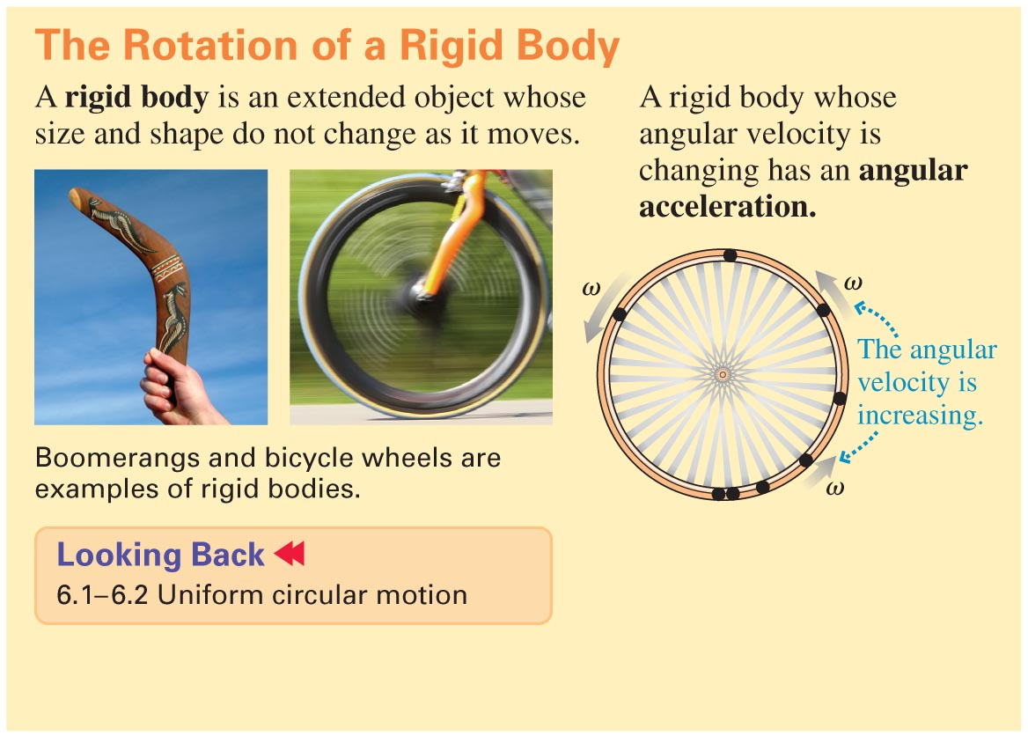
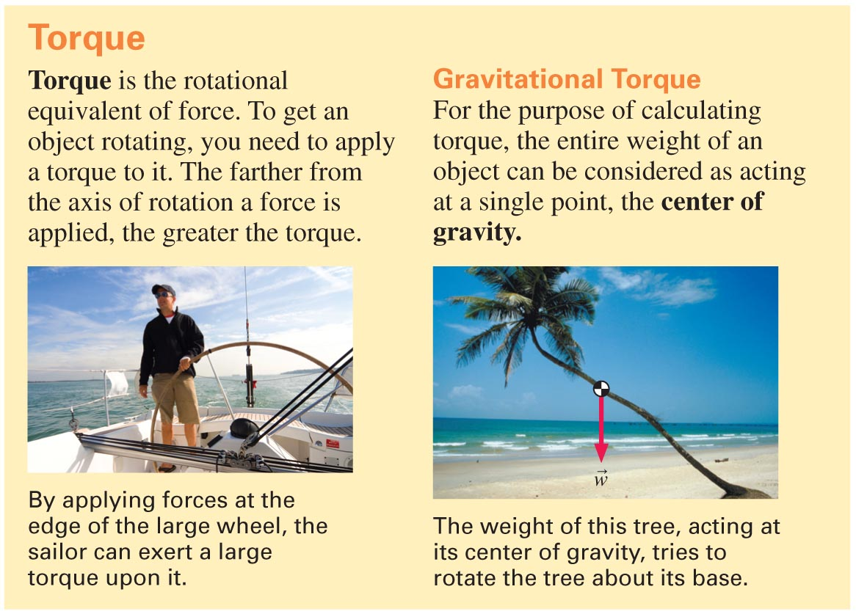

Slide 7-3

Slide 3
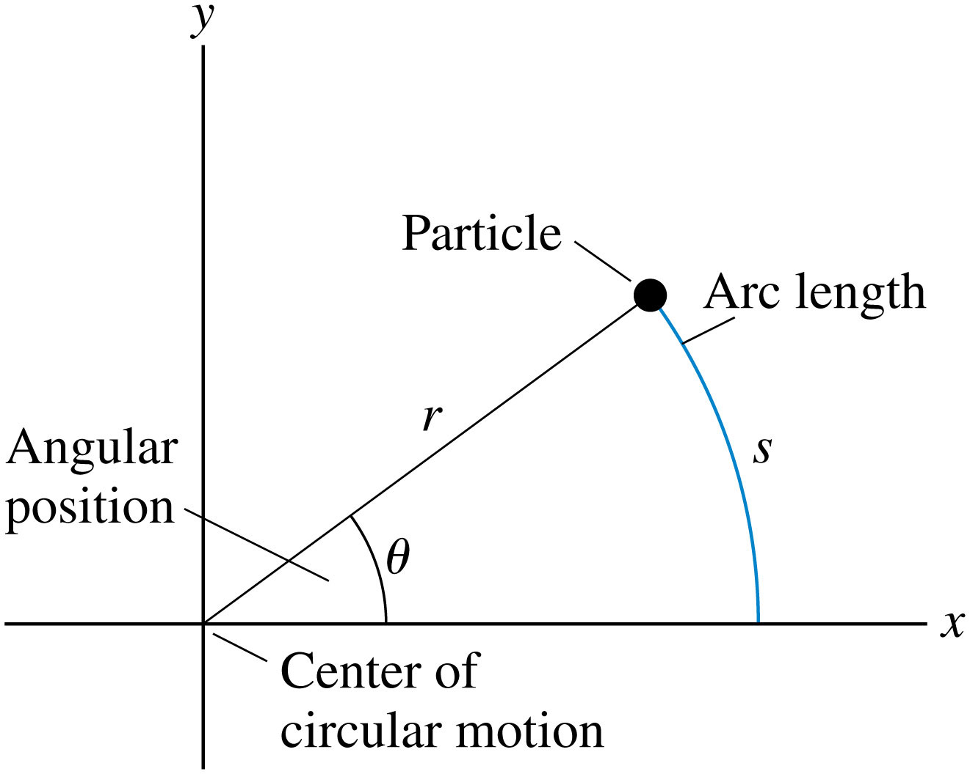

Curvilinear coordinates
$$s=rθ$$
Notes:
FIGURE 7.1

Slide 4
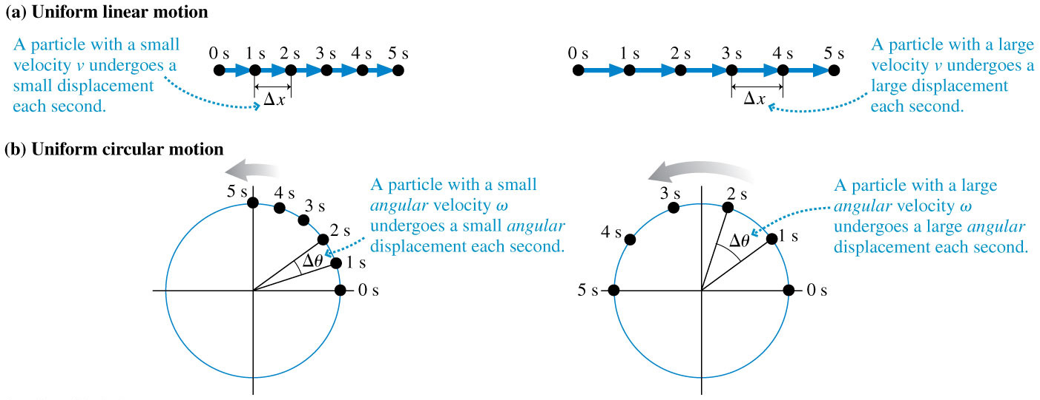


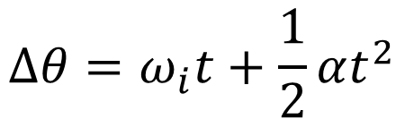
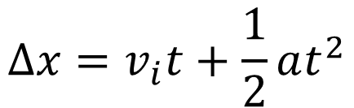
Kinematic equations are the same, just different variables
$$∆x=v_{i}t+\frac{1}{2}at^{2}$$
$$v_{f}^{2}=v_{i}^{2}+2a∆x$$
$$∆θ=ω_{i}t+\frac{1}{2}αt^{2}$$
$$ω_{f}^{2}=ω_{i}^{2}+2α∆θ$$
Notes:
FIGURE 7.2

Slide 5
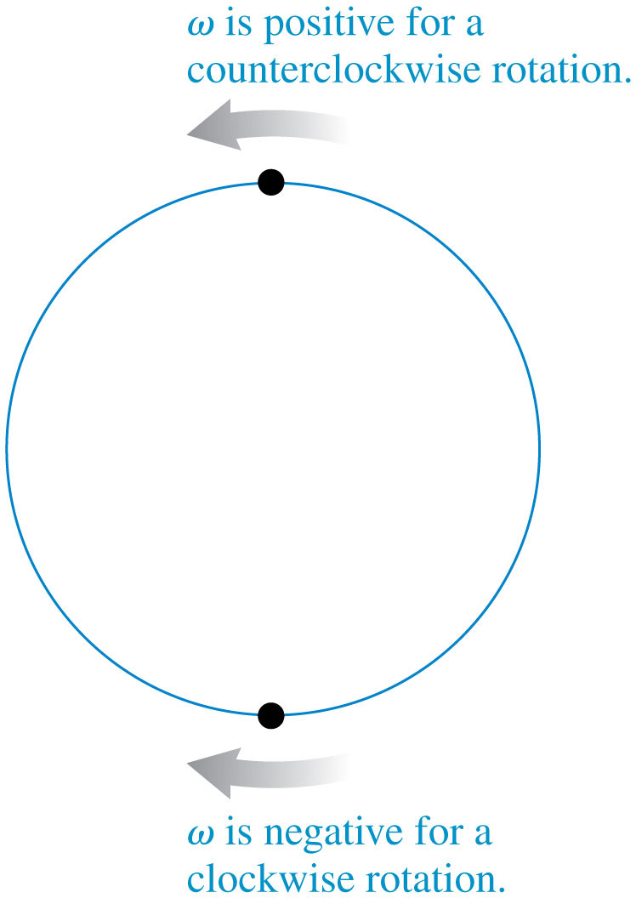
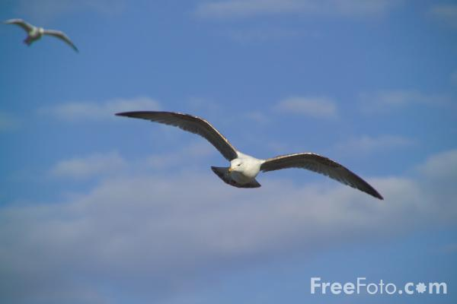

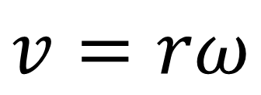
Angular Velocity
$$v=rω$$
$$v$$
“omega”
Notes:
FIGURE 7.3

Slide 6
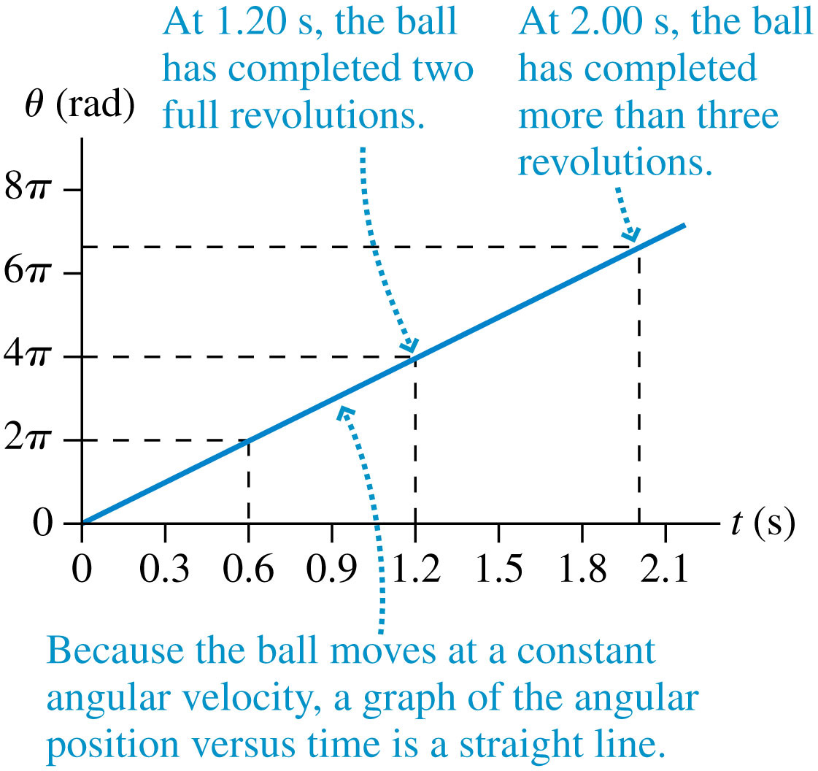
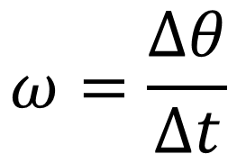

Ball rolling across frictionless floor
$$ω=\frac{∆θ}{∆t}$$
This slope is $ω$
Notes:
FIGURE 7.4

Slide 7

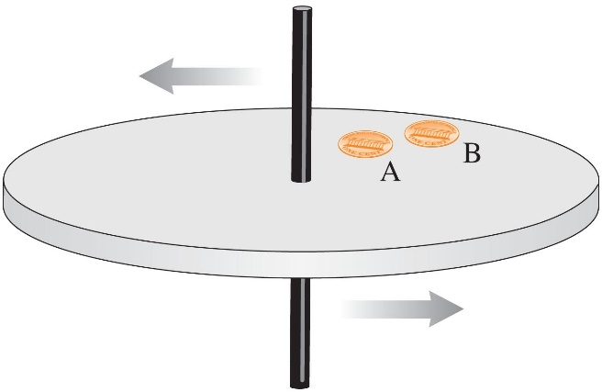
Checking Understanding
Two coins rotate on a turntable. Coin B is twice as far from the axis as coin A.
The angular velocity of A is twice that of B.
The angular velocity of A equals that of B.
The angular velocity of A is half that of B.
Slide 7-13
Notes:
Answer: B

Slide 8
Answer
Two coins rotate on a turntable. Coin B is twice as far from the axis as coin A.
The angular velocity of A is twice that of B.
The angular velocity of A equals that of B.
The angular velocity of A is half that of B.
All points on the turntable rotate through the same angle in the same time.
All points have the same period.
Slide 7-14
Notes:
Answer: B

Slide 9
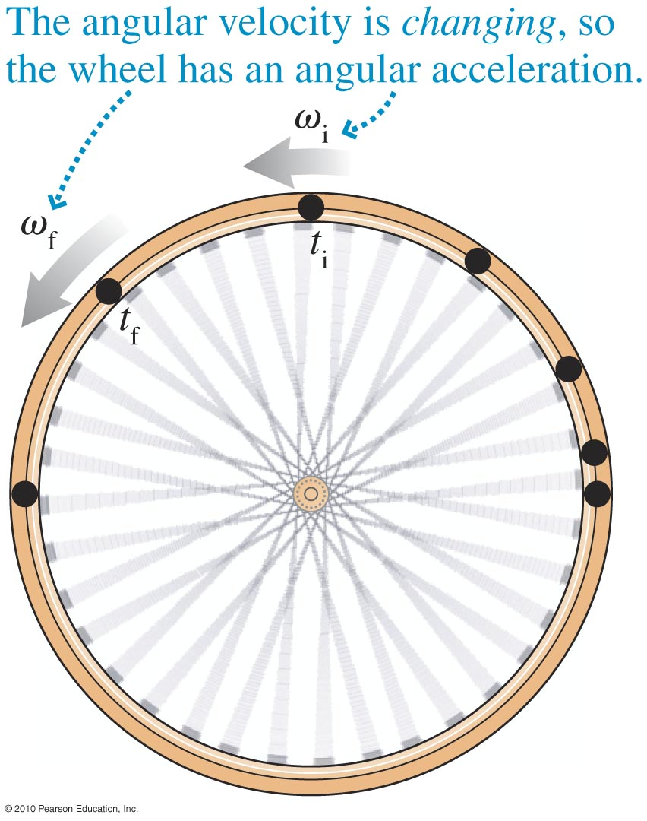
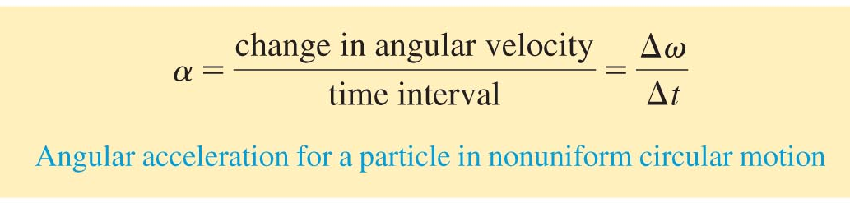

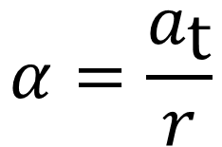
Angular Acceleration
Angular acceleration α measures how rapidly the angular velocity is changing:
$$α=\frac{a_{\text{t}}}{r}$$
$$a_{\text{t}}$$
Tangential acceleration
Slide 7-17

Slide 10
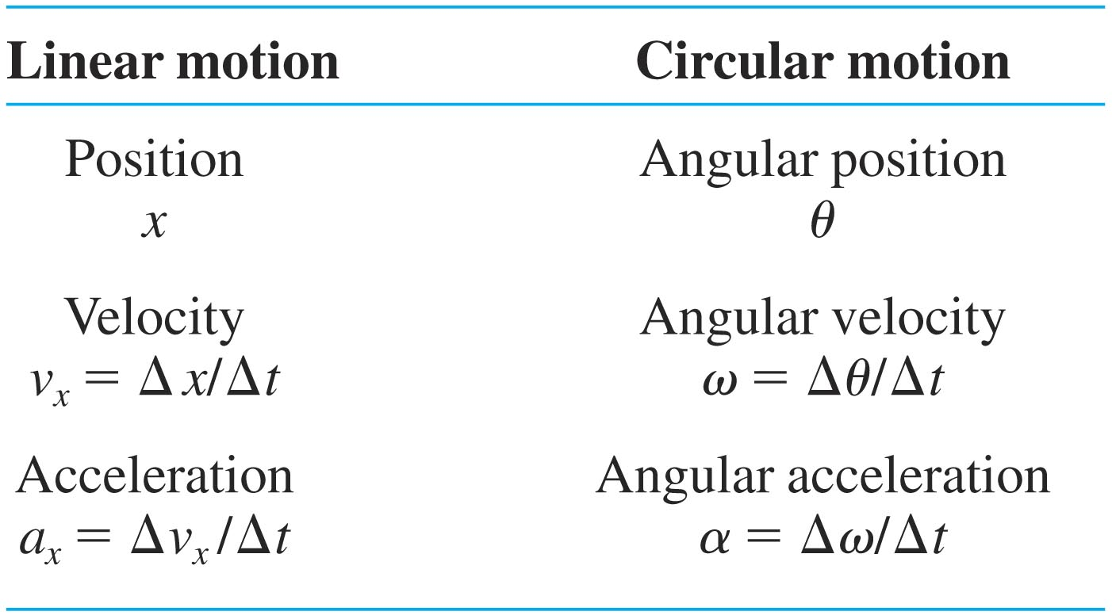
Linear and Circular motion compared
Slide 7-18

Slide 11
Checking Understanding
Two coins rotate on a turntable. Coin B is twice as far from the axis as coin A.
The speed of A is twice that of B.
The speed of A equals that of B.
The speed of A is half that of B.
Slide 7-15
Notes:
Answer: C

Slide 12
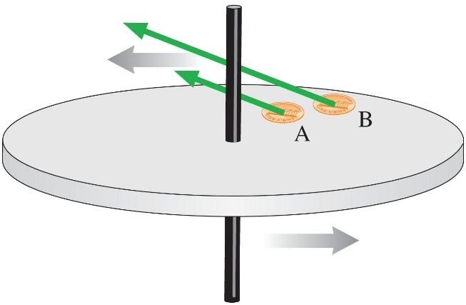
Answer
Two coins rotate on a turntable. Coin B is twice as far from the axis as coin A.
The speed of A is twice that of B.
The speed of A equals that of B.
The speed of A is half that of B.
Twice the radius means twice the speed
Slide 7-16
Notes:
Answer: C

Slide 13
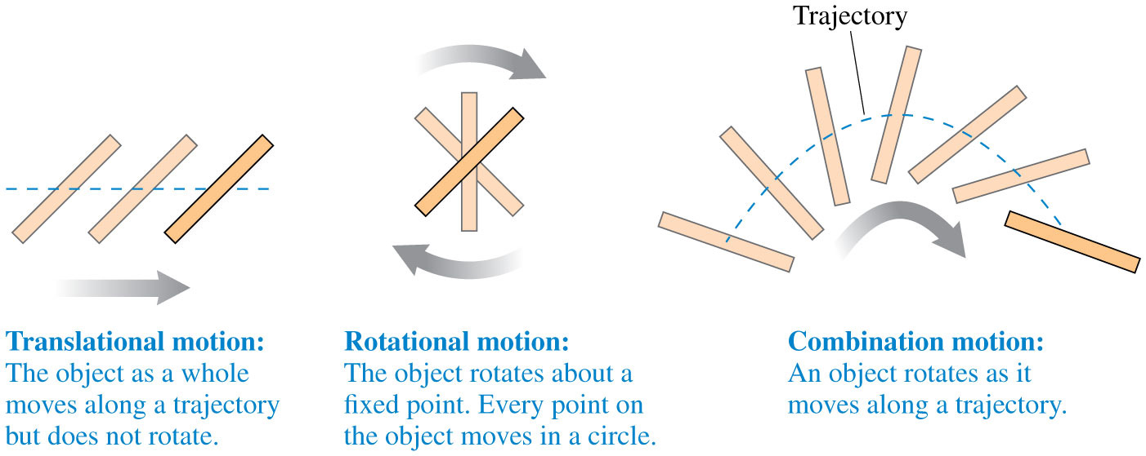
3 types of related motion
Notes:
FIGURE 7.9

Slide 14
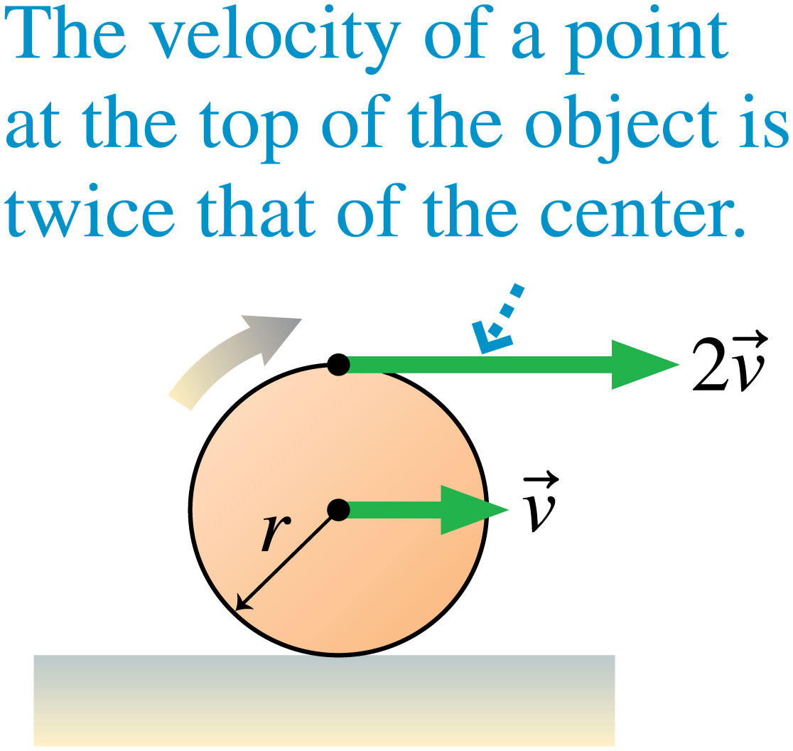
Tangential velocity of circular motion can become linear motion
Notes:
Chapter Summary 7

Slide 15
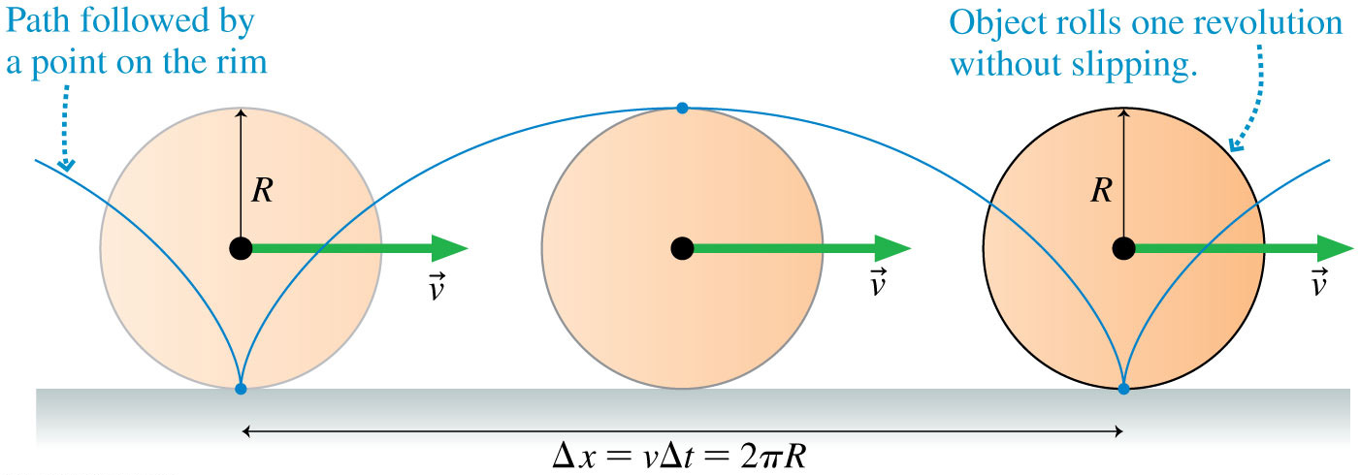
Tangential velocity of circular motion can become linear motion
Notes:
FIGURE 7.42

Slide 16
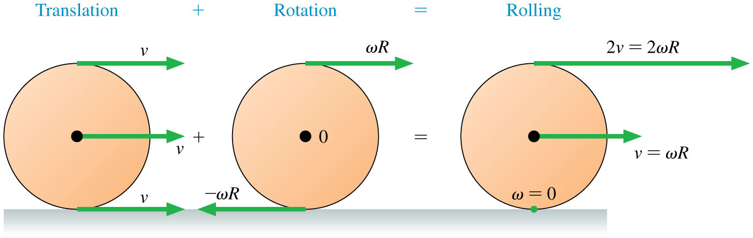
Tangential velocity of circular motion can become linear motion
Notes:
FIGURE 7.43

Slide 17


Combination motion
Center of mass follows original trajectory
$$v$$
$$ω$$
Notes:
FIGURE 7.9

Slide 18
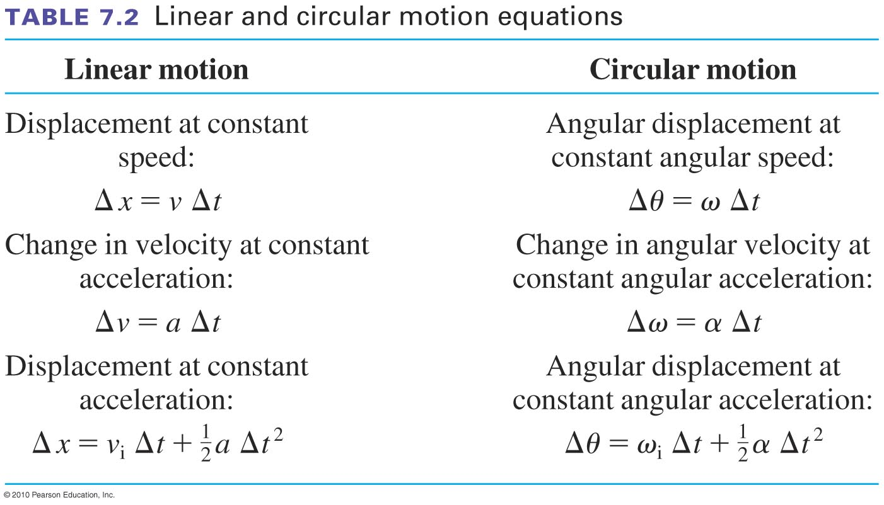
The equations have the same form
Slide 7-19

Slide 19
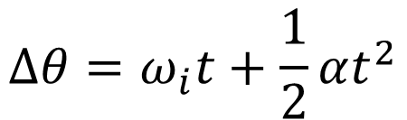
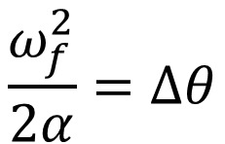
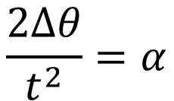

Example Problem
A high-speed drill rotating CCW takes 2.5 s to speed up to 2400 rpm.
What is the drill’s angular acceleration?
B. How many revolutions does it make as it reaches top speed?
$$∆θ=ω_{i}t+\frac{1}{2}αt^{2}$$
$$ω_{f}^{2}=ω_{i}^{2}+2α∆θ$$
$$\frac{ω_{f}^{2}}{2α}=∆θ$$
$$\frac{2∆θ}{t^{2}}=α$$
Slide 7-21

Slide 20
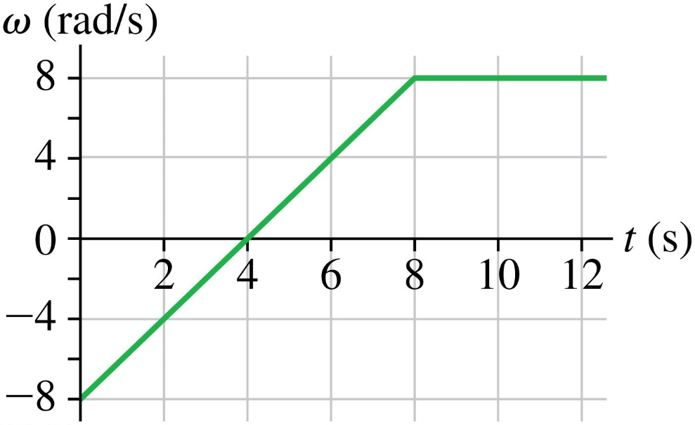
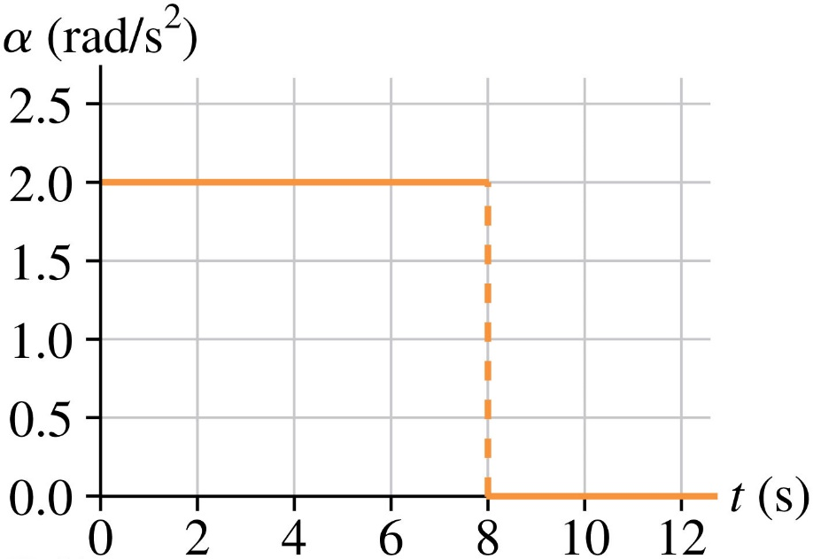
Comparing rotational motion plots
Notes:
FIGURE 7.13

Slide 21
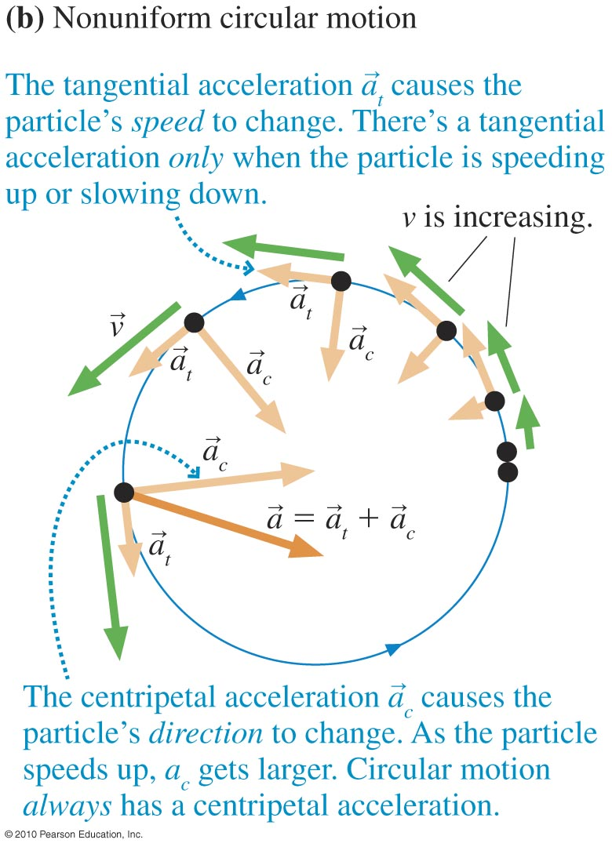
Centripetal and Tangential acceleration
Slide 7-22

Slide 22
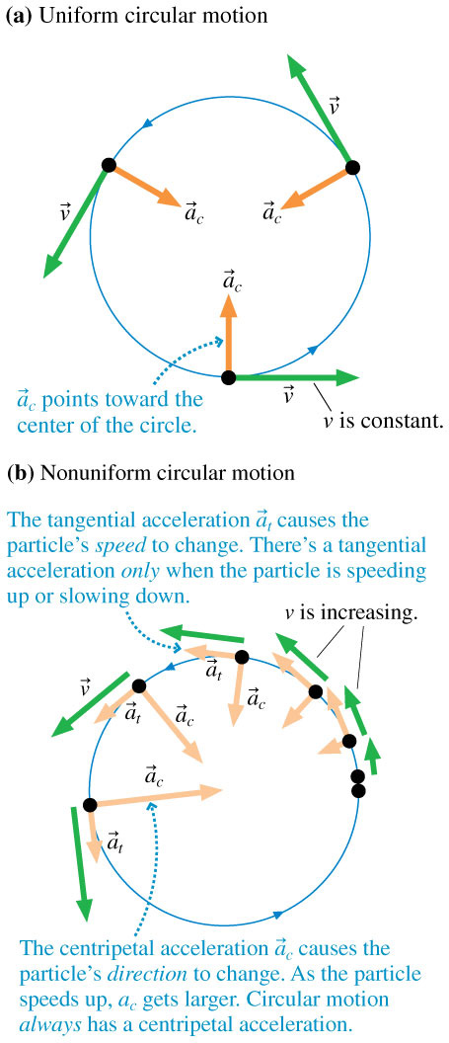
The difference of nonuniform circular motion
The speed is changing
Notes:
FIGURE 7.15

Slide 23
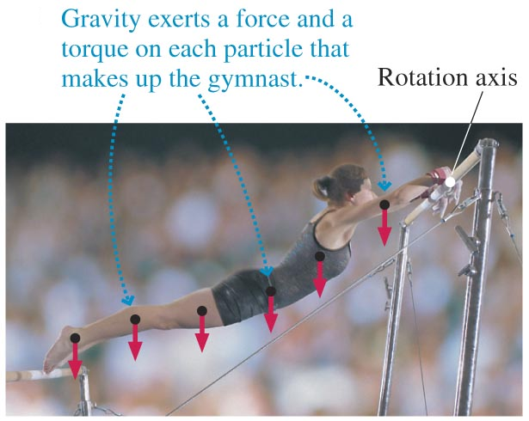
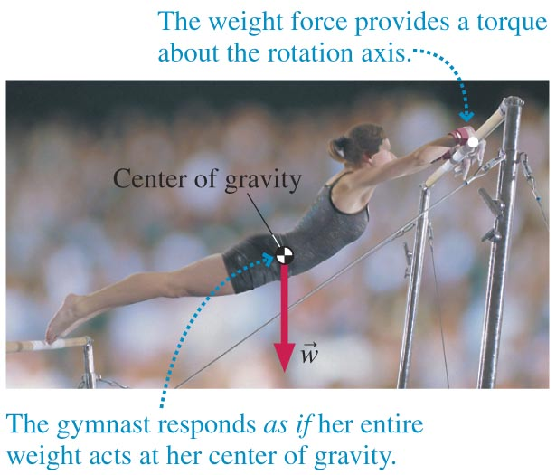
Center of Gravity
=
Slide 7-29

Slide 24
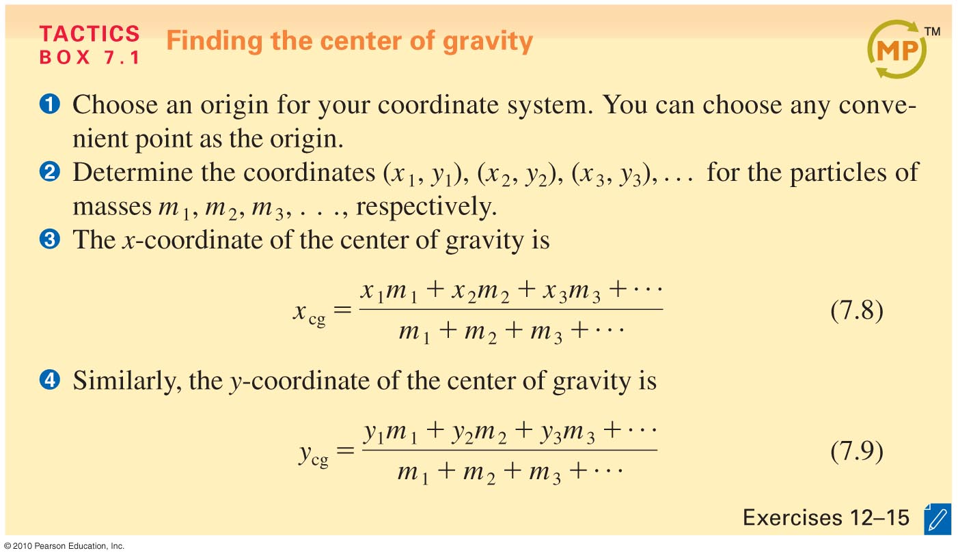
Calculating the Center-of-Gravity Position
Slide 7-30

Slide 25
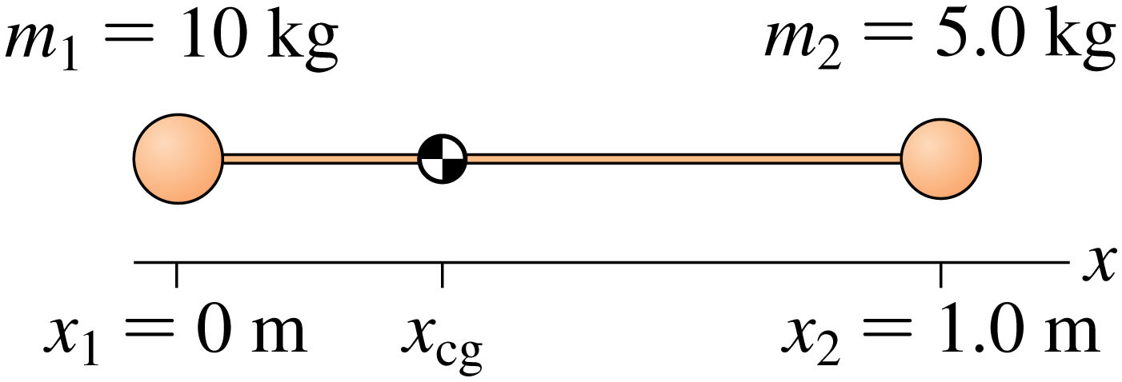
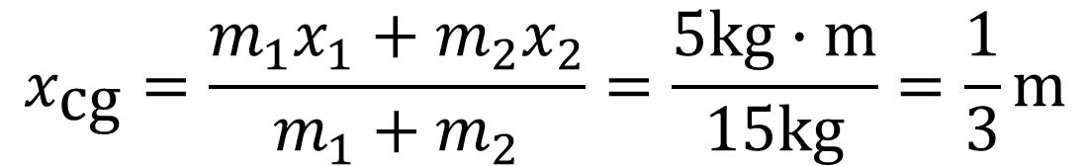
Center of mass practice
$$x_{\text{cg}}=\frac{m_{1}x_{1}+m_{2}x_{2}}{m_{1}+m_{2}}=\frac{5\text{kg}∙\text{m}}{15\text{kg}}=\frac{1}{3}\text{m}$$
Notes:
FIGURE 7.30

Slide 26
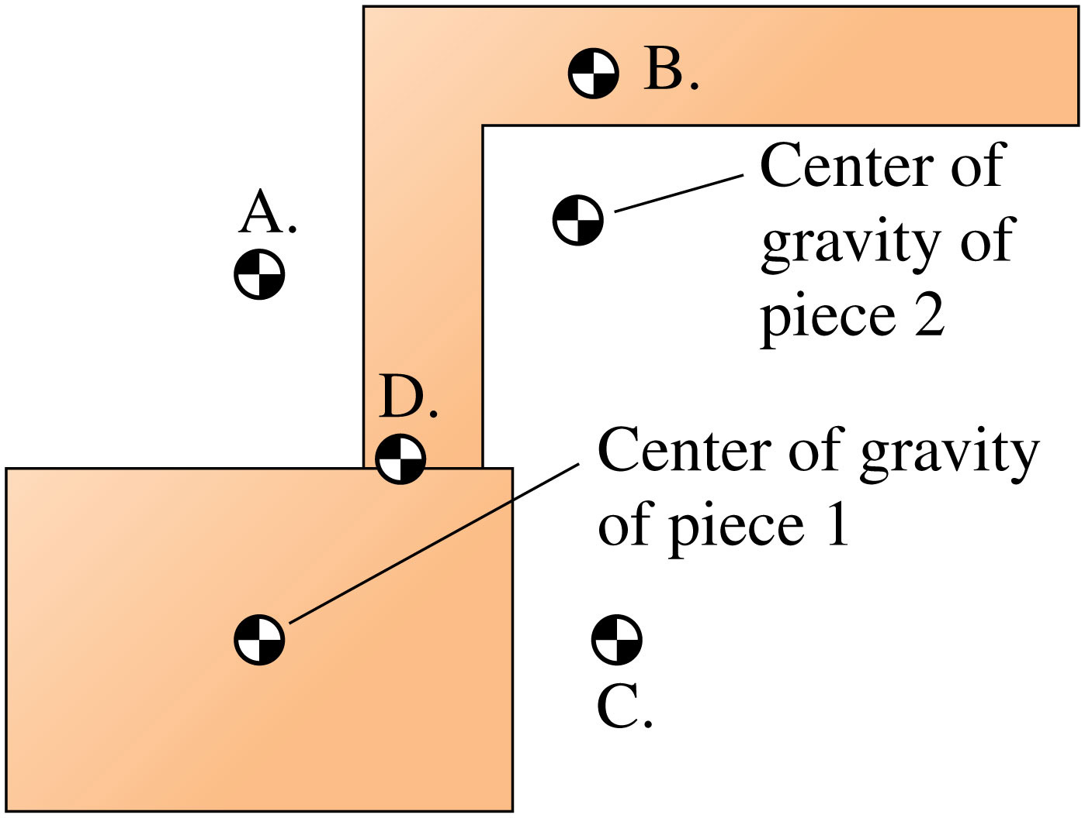
Notes:
FIGURE Q7.19

Slide 27
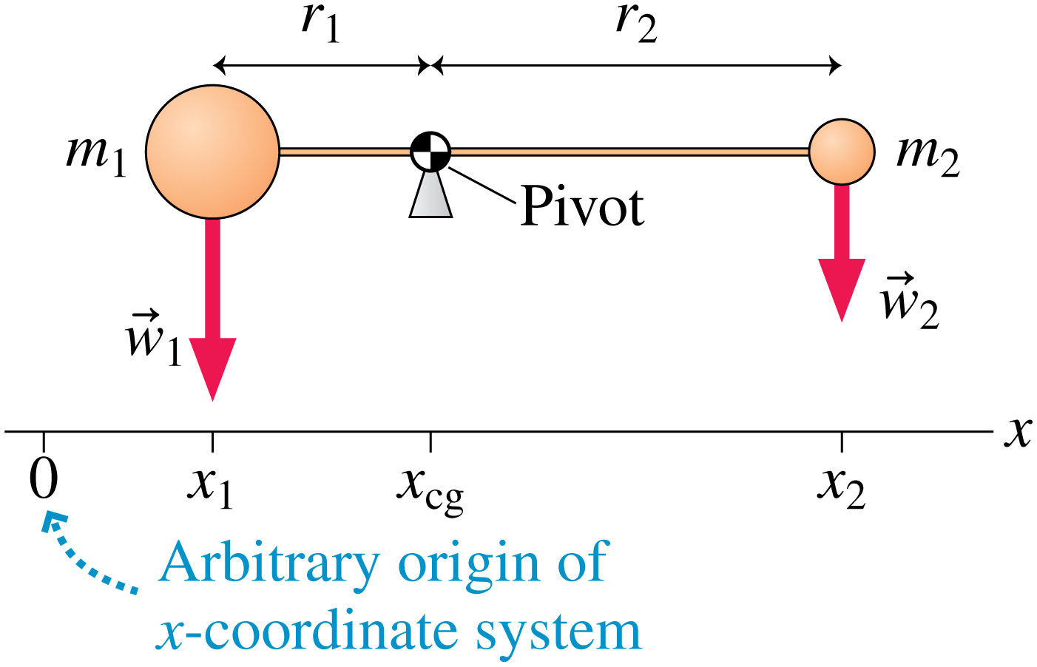
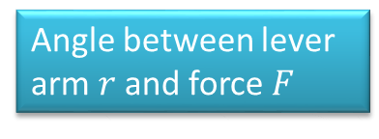
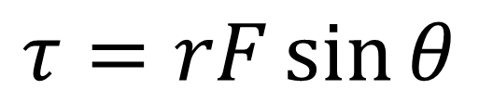
Torque –when force causes circular motion
$$τ=rF\sin{θ}$$
Angle between lever arm $r$ and force $F$
Notes:
FIGURE 7.29

Slide 28
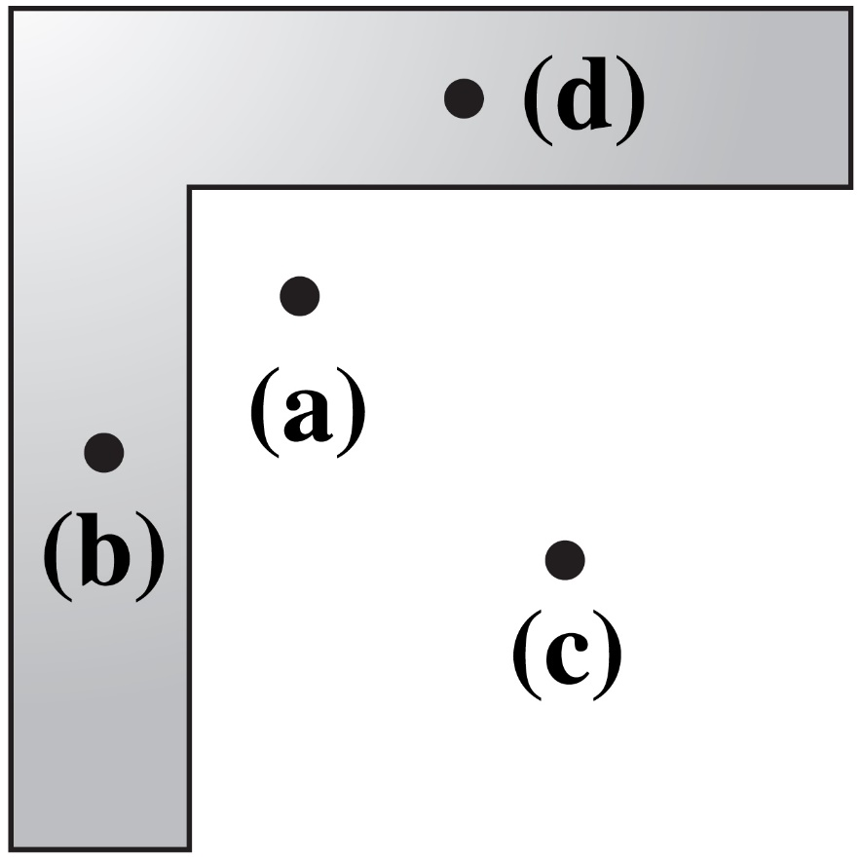
Checking Understanding
Which point could be the center of gravity of this L-shaped piece?
Slide 7-32
Notes:
Answer: A

Slide 29
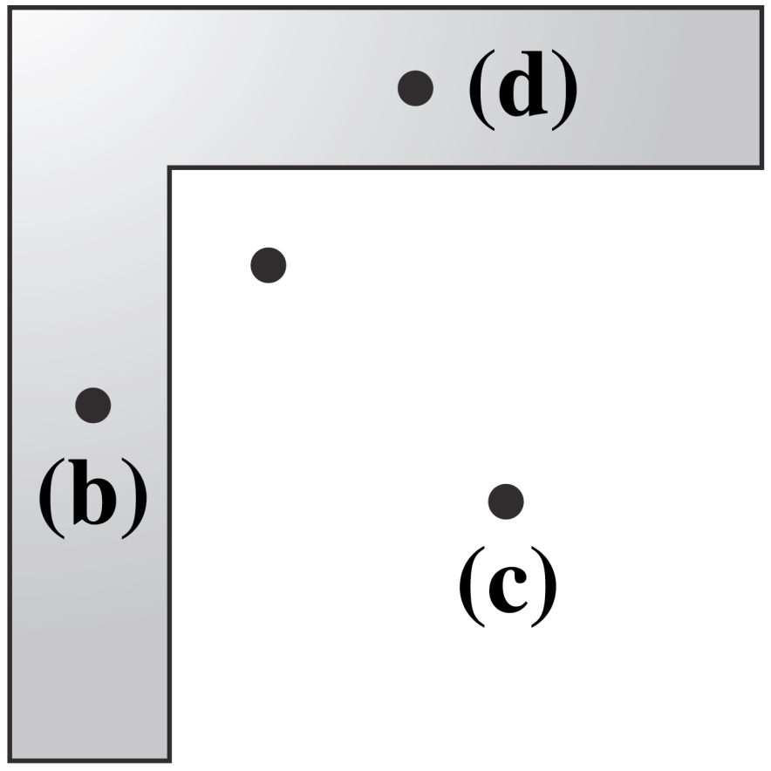
Answer
Which point could be the center of gravity of this L-shaped piece?
(a)
Slide 7-33
Notes:
Answer: A

Slide 30
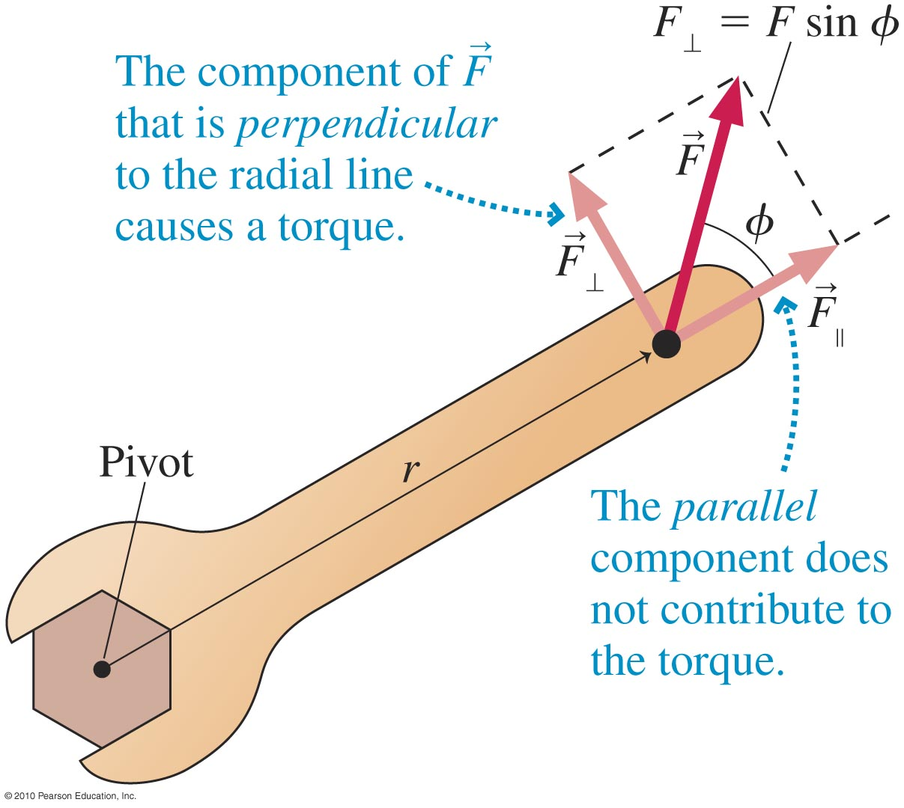
Interpreting Torque
Torque is due to the component of the force perpendicular to the radial line.
Slide 7-25

Slide 31
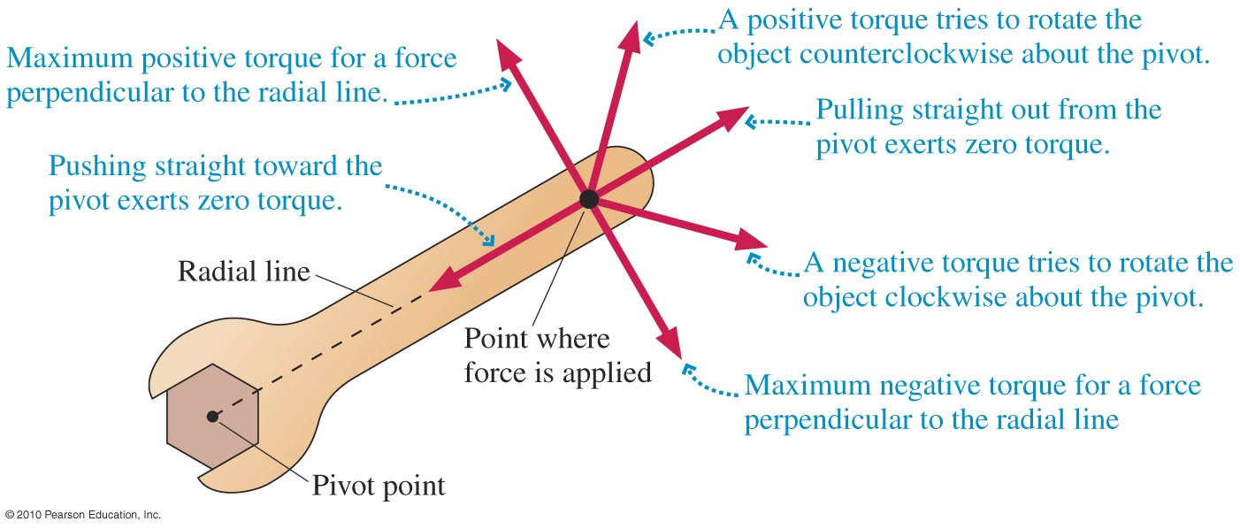
Signs and Strengths of the Torque
Slide 7-27

Slide 32
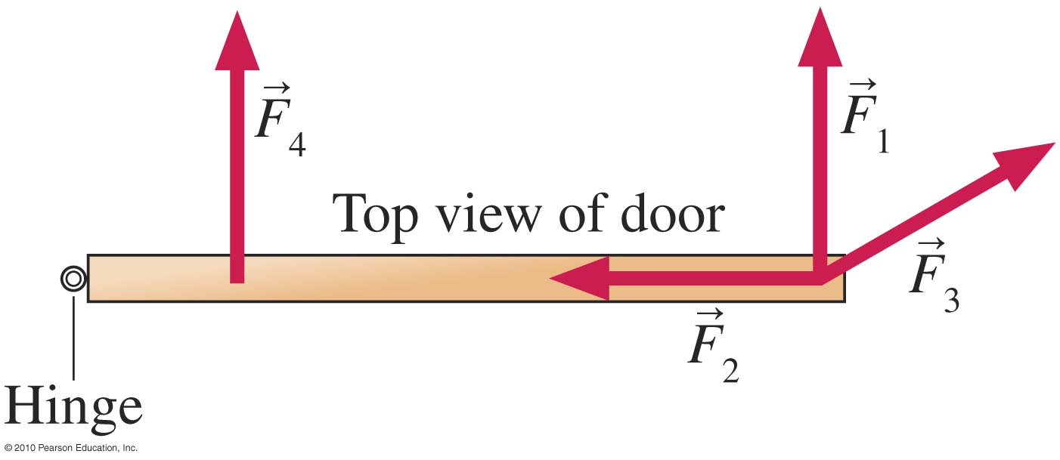

The four forces below are equal in magnitude. Which force would be most effective in opening the door?
$F_{1}$
$F_{2}$
$F_{3}$
$F_{4}$
Either $F_{1}$ or $F_{3}$

Slide 33





Example torque Problem
$$τ=rF\sin{θ}$$
Revolutionaries attempt to pull down a statue of the Great Leader by pulling on a rope tied to the top of his head. The statue is 17 m tall, and they pull with a force of 4200 N at an angle of 65° to the horizontal. What is the torque they exert on the statue? If they are standing to the right of the statue, is the torque positive or negative?
$$τ=17\text{m}∙4200\text{N}∙\sin{θ}$$
$$θ≠{65}^{°}$$
$$τ=17\text{m}∙4200\text{N}∙\sin{{25}^{°}}$$
17 m
Negative torque, but why?
r = 17m
Rotating it in the CW direction
65°
F = 4200 N
pivot
Slide 7-28

Slide 34
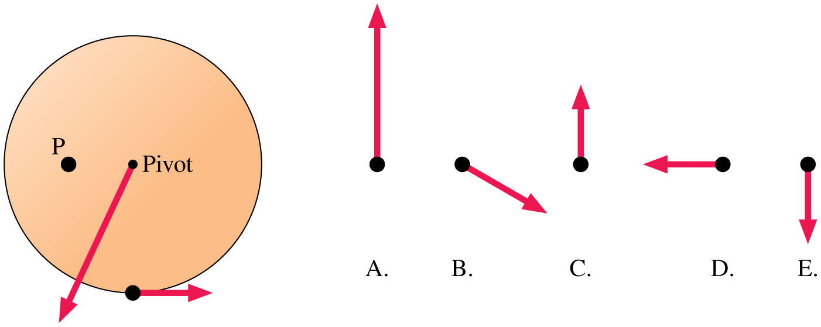
Which force vector on point P would keep the wheel from spinning?
A
C
D
E

Slide 35
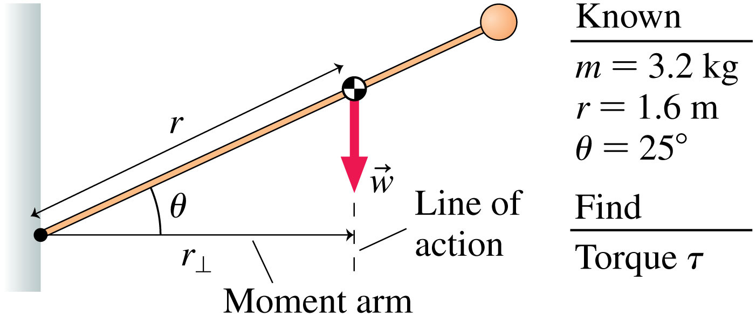

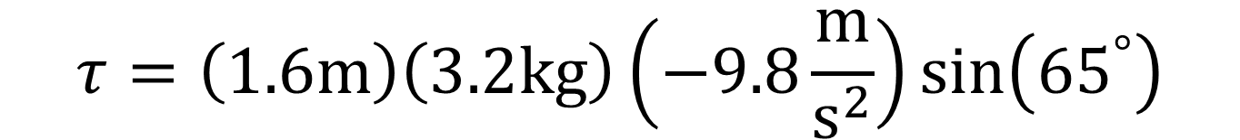


Torque practice
$$τ=rF\sin{θ }$$
$$θ$$
$$τ=rmg\sin{θ}$$
$$τ=\left(1.6\text{m}\right)\left(3.2\text{kg}\right)\left(−9.8\frac{\text{m}}{{\text{s}}^{2}}\right)\sin\left({65}^{°}\right)$$
Notes:
FIGURE 7.26

Slide 36

Which torques are equal?
B = C = D = E only
A = B and C = D = E
None are equal
B = E and C = D

Slide 37


Torque practice with centers of mass
What is the Net Torque is exerted by the gymnast about an axis through the rings?
Notes:
Chapter 7 Unnumbered Figure, Page 205

Slide 38






Torque equilibrium
$$\sum{\vec{τ}}=0$$
$$r_{1}$$
$$r_{2}$$
$$F_{1}$$
$$F_{2}$$
Notes:
FIGURE 7.32

Slide 39
Reading Quiz
Which factor does the torque on an object not depend on?
The magnitude of the applied force.
The object’s angular velocity.
The angle at which the force is applied.
The distance from the axis to the point at which the force is applied.
Slide 7-7
Notes:
Answer: B

Slide 40
Answer
Which factor does the torque on an object not depend on?
The magnitude of the applied force.
The object’s angular velocity.
The angle at which the force is applied.
The distance from the axis to the point at which the force is applied.
Slide 7-8
Notes:
Answer: B

Slide 41



Example Problem
An object consists of the three balls shown, connected by massless rods. Find the x- and y-positions of the object’s center of gravity.
$$x_{\text{cg}}=\frac{m_{1}x_{1}+m_{2}x_{2}+m_{3}x_{3}}{m_{1}+m_{2}+m_{3}}$$
$$y_{\text{cg}}=\frac{m_{1}y_{1}+m_{2}y_{2}+m_{3}y_{3}}{m_{1}+m_{2}+m_{3}}$$
Slide 7-31

Slide 42


An object consists of the three balls shown, connected by massless rods. Find the x- and y-positions of the object’s center of gravity.
$$x_{\text{cg}}=\frac{m_{1}\left(0\right)+m_{2}\left(0\right)+m_{3}\left(1\text{m}\right)}{m_{1}+m_{2}+m_{3}}=\frac{2\text{kg}∙\text{m}}{4\text{kg}}=\frac{1}{2}\text{m}$$
$$y_{\text{cg}}=\frac{m_{1}\left(1\text{m}\right)+m_{2}\left(0\right)+m_{3}\left(0\right)}{m_{1}+m_{2}+m_{3}}=\frac{1\text{kg}∙\text{m}}{4\text{kg}}=\frac{1}{4}\text{m}$$
The center of mass for these 3 bodies
Slide 7-31

Slide 43

The moment of Inertia
the rotational equivalent of mass

Slide 44

Newton’s Second Law for Rotation
I = moment of inertia. Objects with larger moments of inertia are harder to get rotating.
Slide 7-34

Slide 45

Rotational and Linear Dynamics Compared
Slide 7-36

Slide 46



Which moment of inertia is greatest?
$$m$$
$$M$$
A
B
C
D

Slide 47

Which force vector applied to point P will stop this rolling ball?
A
B
C
D
E

Slide 48


Formulas more common moments of inertia
$$I$$
Notes:
Chapter Summary 6

Slide 49

Which red vector is your best bet for getting this bolt as tight as possible?
A
B
C
D

Slide 50
Reading Quiz
Moment of inertia is
the rotational equivalent of mass.
the point at which all forces appear to act.
the time at which inertia occurs.
an alternative term for moment arm.
Slide 7-5
Notes:
Answer: A

Slide 51
Answer
Moment of inertia is
the rotational equivalent of mass.
the point at which all forces appear to act.
the time at which inertia occurs.
an alternative term for moment arm.
Slide 7-6
Notes:
Answer: A

Slide 52



Torque causing rotation
$$\sum{τ≠0}$$
$$\sum{τ=}Iα$$
What happens to these masses when you let go?
Notes:
FIGURE P7.65

Slide 53

What happens to this pulley system?
It does not move
The 10N force accelerates the mass upward
The force of gravity on the mass results in a net force upward
The mass moves upward at a constant speed

Slide 54









Do we always have to use torque?
Starting from rest, how long does it take to hit the ground?
$$\sum{F_{1}=}F_{g1}+T_{1}=m_{1}a_{1}$$
$$T_{1}$$
$$\sum{F_{2}=}F_{g2}+T_{2}=m_{2}a_{2}$$
$$T_{1}$$
Newton’s Third
$$F_{g}$$
$$T_{2}$$
$$T_{1}=−T_{2}$$
$$F_{g}$$
Notes:
FIGURE P7.69

Slide 55










Starting from rest, how long does it take to hit the ground?
Use forces to solve
$$a_{2}=a_{1}=a$$
$$m_{1}g+T_{1}=m_{1}a$$
$$m_{2}\left|g\right|−T_{1}=m_{2}a$$
Get rid of $T_{1}$ by solving for it and substituting into the other equation
$$T_{1}$$
$$a=−3.27\frac{\text{m}}{{\text{s}}^{2}}$$
$$a_{1}$$
$$a_{2}$$
$$∆y=v_{iy}t+\frac{1}{2}at^{2}$$
$$F_{g}$$
$$T_{2}$$
$$t=\sqrt{\frac{2∆y}{a}}$$
$$t=.78\text{s}$$
$$F_{g}$$
Notes:
FIGURE P7.69

Slide 56
Reading Quiz
A net torque applied to an object causes
a linear acceleration of the object.
the object to rotate at a constant rate.
the angular velocity of the object to change.
the moment of inertia of the object to change.
Slide 7-11
Notes:
Answer: C

Slide 57
Answer
A net torque applied to an object causes
a linear acceleration of the object.
the object to rotate at a constant rate.
the angular velocity of the object to change.
the moment of inertia of the object to change.
Slide 7-12
Notes:
Answer: C

Slide 58



Friction in rotational motion
Draw the normal force for the wheel against the break
Draw the frictional force from the break
$$N_{b}$$
$$F_{f}$$
Notes:
FIGURE P7.70

Slide 59

Is this beam balanced?
Yes
No, it will spin CW
No, it will spin CCW
Not enough information

Slide 60




Now the pulley has friction
$$I_{p}=\frac{1}{2}m_{p}r^{2}$$
$$\sum{τ=}τ_{1}+τ_{2}=I_{p}α$$
Notes:
FIGURE 7.39

Slide 61


Now the pulley has friction and mass
$$I_{p}=\frac{1}{2}m_{p}r^{2}$$
$$4 \text{kg}$$
$$.02\text{m}∙20\text{N}−\text{.02}\text{m}∙30\text{N}=\left(.0008 \text{kg}∙{\text{m}}^{2}\right)α$$
Notes:
FIGURE 7.39

Slide 62


Additional Example Problem
A baseball bat has a mass of 0.82 kg and is 0.86 m long. It’s held vertically and then allowed to fall. What is the bat’s angular acceleration when it has reached 20° from the vertical? (Model the bat as a uniform cylinder).
Slide 7-43

